Slide 1
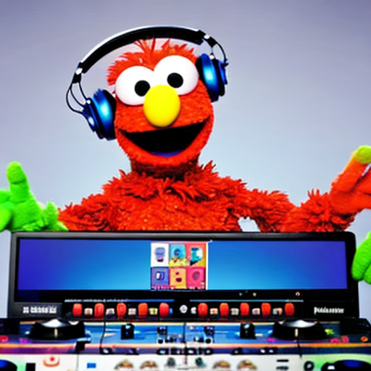
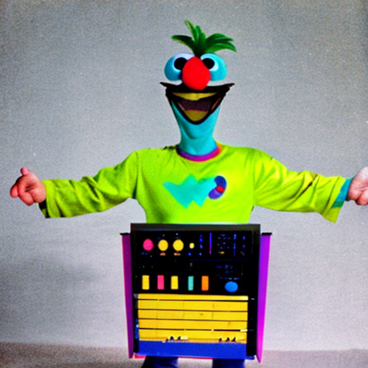
Fine tuning BERT
Prompt: Bert from sesame street dressed as a synthesizer
Prompt: Ernie from sesame street is a DJ with headphones on one ear
For Sentiment Classification
*Images generated by stable-diffusion

Slide 2
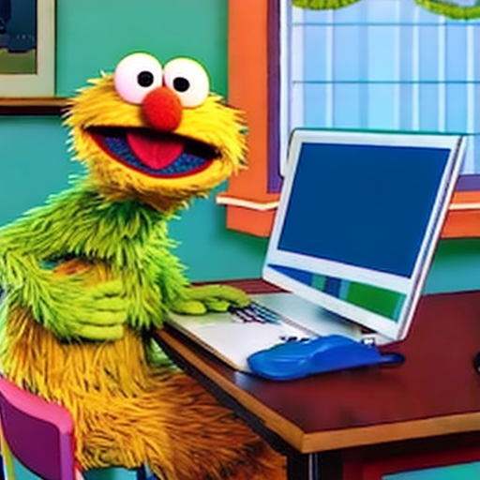
Why are you here?
Me?
Prompt: Sesame street character sitting at a desk

Slide 3
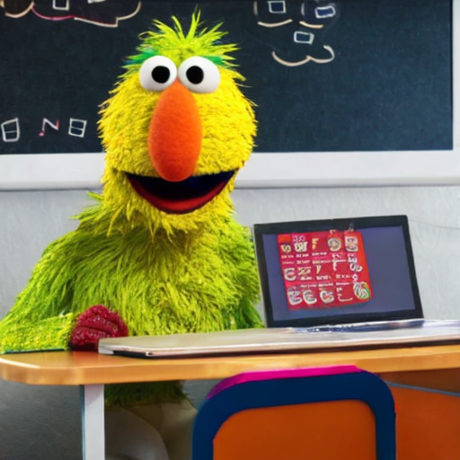
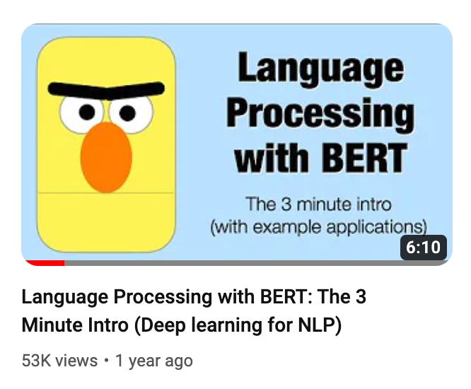
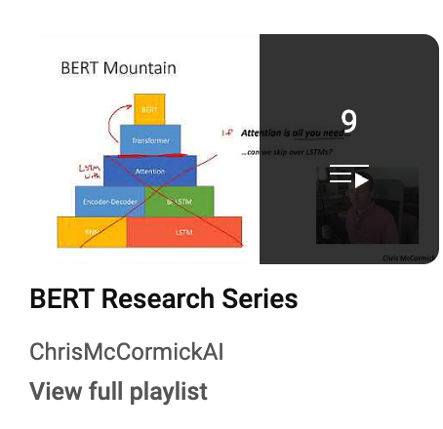
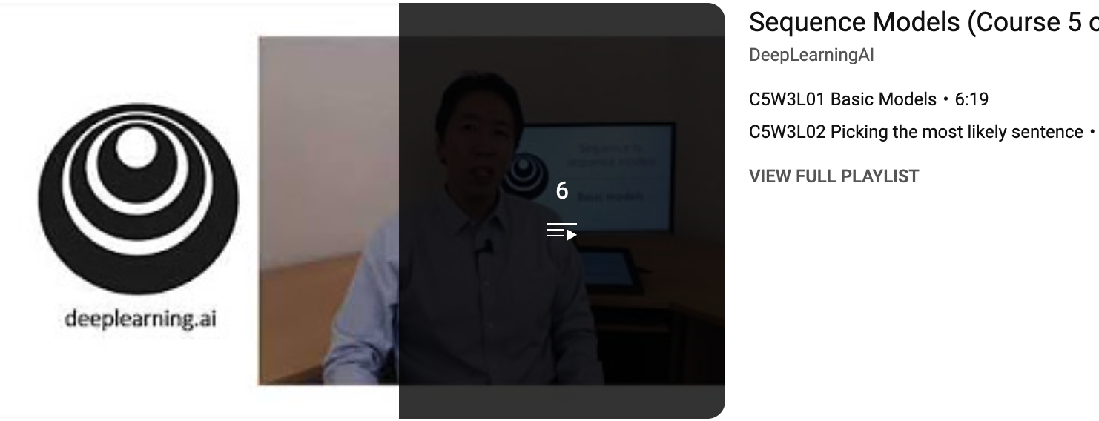
Jay Alammar
I want to specialize in NLP!
Chris Mccormick
Andrew Ng
Prompt: A polyglot sesame street character sitting at a desk

Slide 4
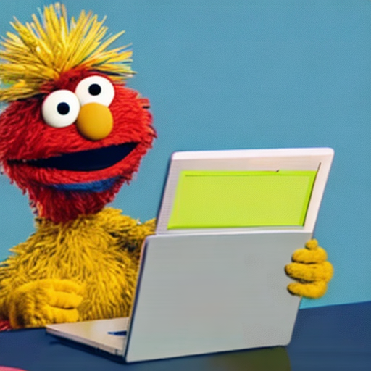
I’m a product manager and sentiment analysis is on our roadmap for Q3.
[ recommended free youtube videos on Sentiment Analysis Case studies ]
Prompt: A sesame street character who is a product manager sitting at a desk

Slide 5
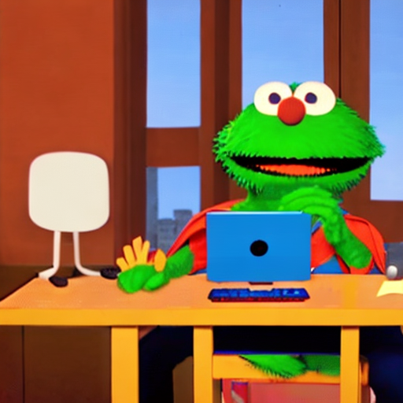
I want to apply what I learn today to improve society
Healthcare
Public Opinion
Disaster Response
Mental Health
Prompt: A super hero sesame street character sitting at a desk

Slide 6
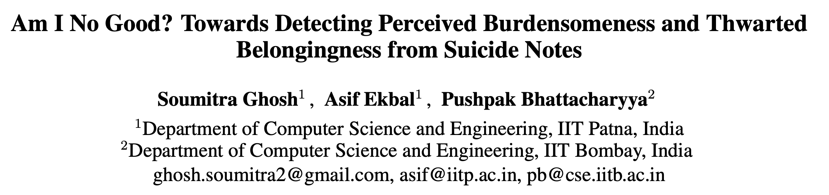
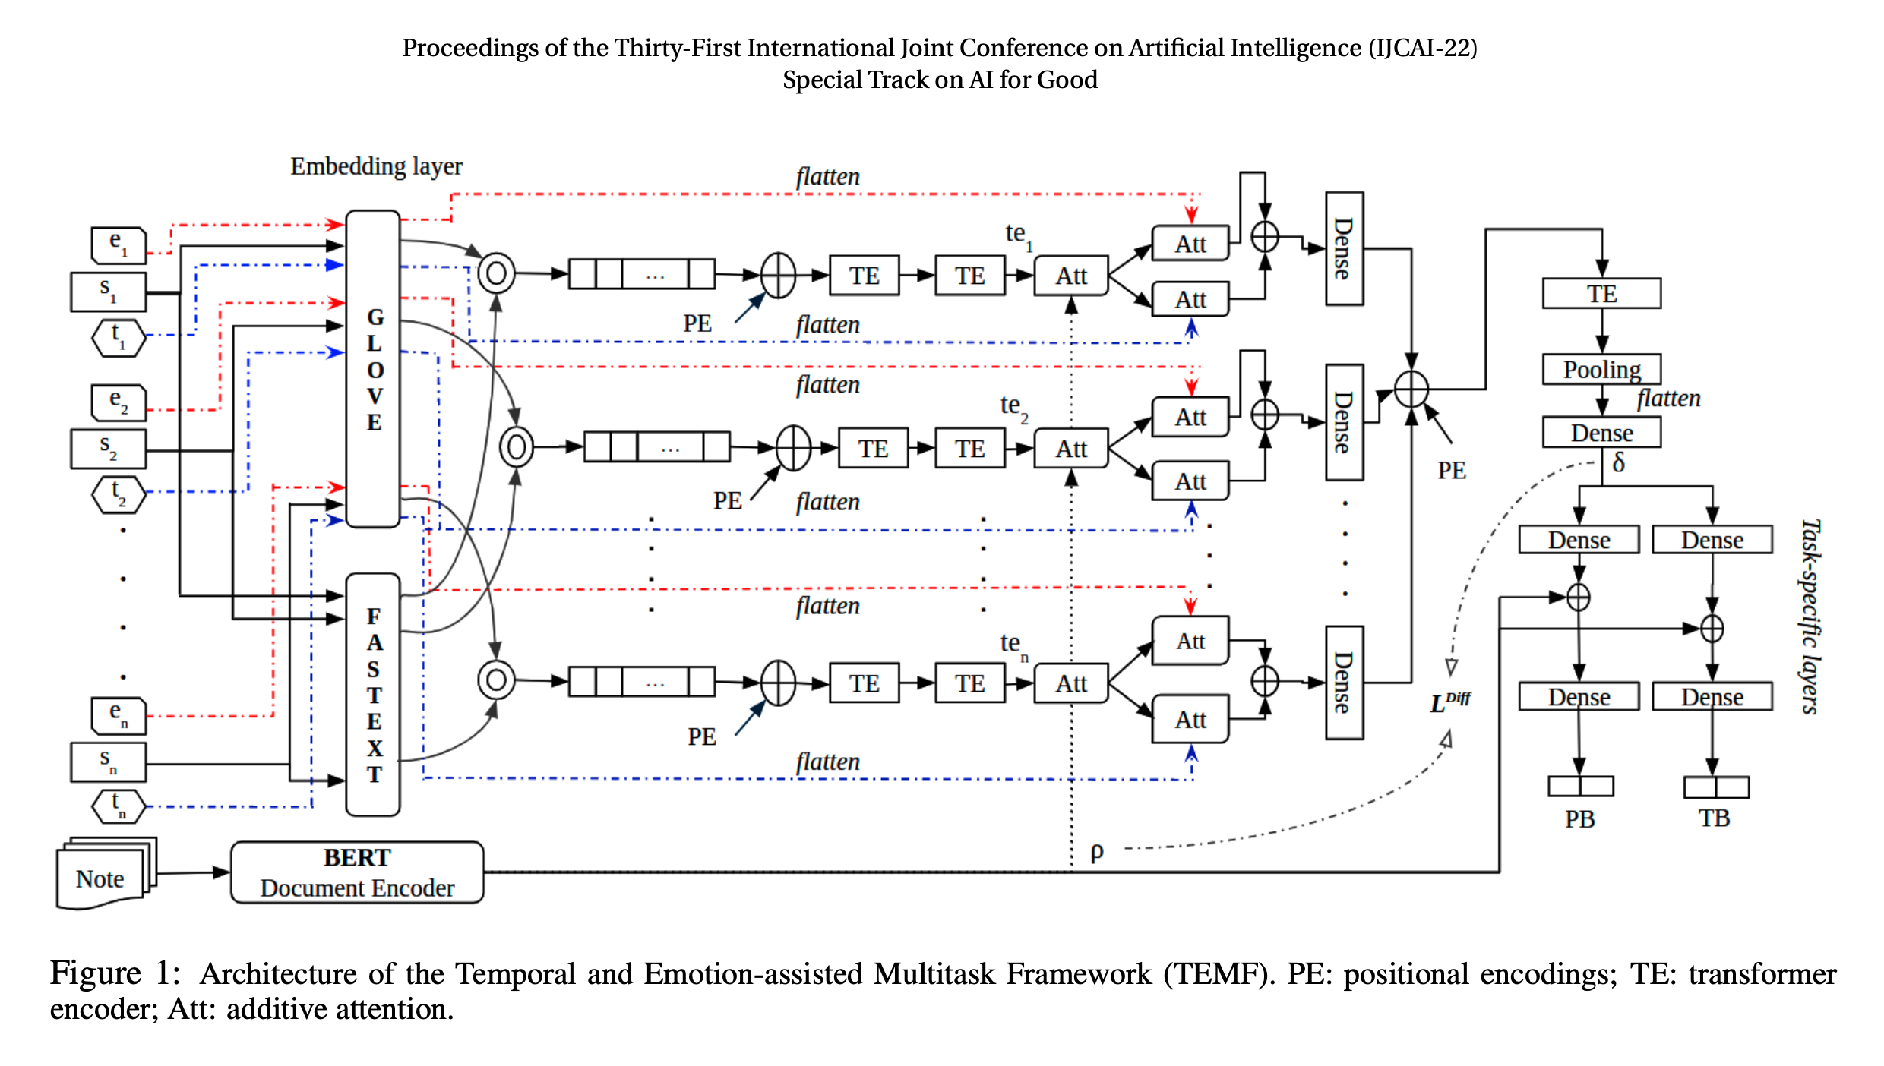
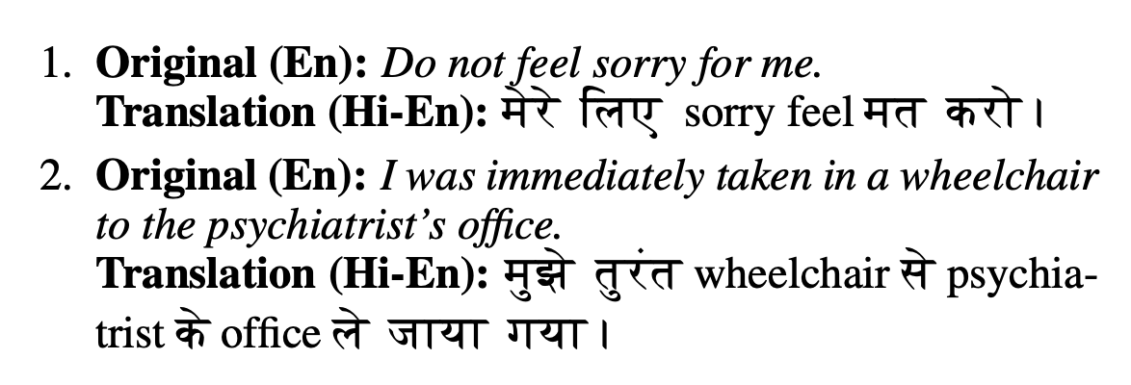
One in 100 deaths is by suicide ^{[1]}
^{[2]}
“a code-mixed text has a dominant language or matrix language (here, Hindi) and an inserted language or embedded language (here, English)”
https://www.who.int/news/item/17-06-2021-one-in-100-deaths-is-by-suicide
https://www.ijcai.org/proceedings/2022/0704.pdf

Slide 7
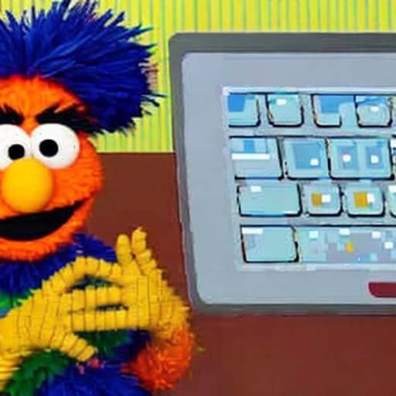

I’m a software engineer and I want to create ML apps with vision and generative models too.
Prompt: A sesame street character who is a software engineer sitting at a desk

Slide 8
Ultimately, we all follow tutorials hoping to transfer what we learn to use-cases we care about

Slide 9
Ultimately, we all follow tutorials hoping to transfer what we learn to use-cases we care about

Slide 10
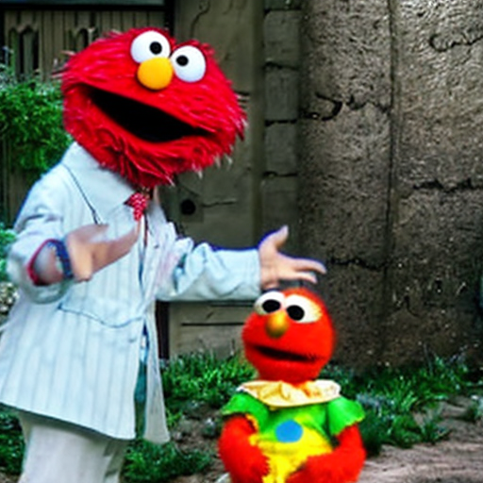
Ultimately, we all follow tutorials hoping to transfer what we learn to use-cases we care about
Transfer Learning
Image generated by stable-diffusion.
Prompt: sesame street character amazed by understanding a new concept

Slide 11
Transfer Learning
From Wikipedia
Transfer learning (TL) is a research problem in machine learning (ML) that focuses on applying knowledge gained while solving one task to a related task.^{[1]} For example, knowledge gained while learning to recognize cars could be applied when trying to recognize trucks. This topic is related to the psychological literature on transfer of learning, although practical ties between the two fields are limited. Reusing/transferring information from previously learned tasks to new tasks has the potential to significantly improve learning efficiency.^{[2]}

Slide 12
Transfer Learning (Machines)
Transfer of Learning (Humans)
From Wikipedia
Transfer learning (TL) is a research problem in machine learning (ML) that focuses on applying knowledge gained while solving one task to a related task.^{[1]} For example, knowledge gained while learning to recognize cars could be applied when trying to recognize trucks. This topic is related to the psychological literature on transfer of learning, although practical ties between the two fields are limited. Reusing/transferring information from previously learned tasks to new tasks has the potential to significantly improve learning efficiency.^{[2]}
From Wikipedia
Transfer of learning occurs when people apply information, strategies, and skills they have learned to a new situation or context. Transfer is not a discrete activity, but is rather an integral part of the learning process. Researchers attempt to identify when and how transfer occurs and to offer strategies to improve transfer.
=

Slide 13
Transfer Learning (Machines)
Transfer of Learning (Humans)
BERT:
Base knowledge:
A statistical understanding of natural language
Learned from:
”Dummy tasks”: Masked Language Modeling (MLM) & Next Sentence Prediction (NSP)
Today’s Fine-tuning Objective:
Learn how to classify the sentiment of piece of text
You:
Base knowledge:
An intuitive and rule-based understanding of language
Learned from:
”Dummy tasks”: Watching Sesame Street, reading Nancy Drew, grammar classes
Today’s Fine-tuning Objective:
Learn how to fine-tune a model for a custom task
=

Slide 14
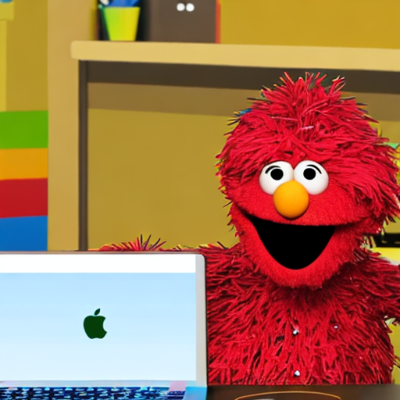
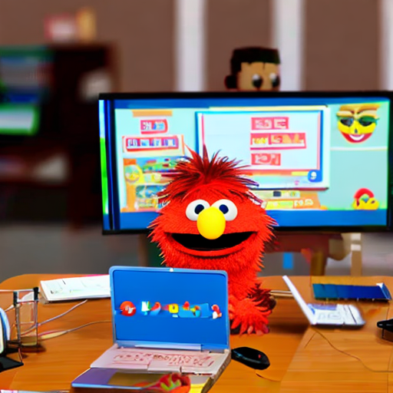
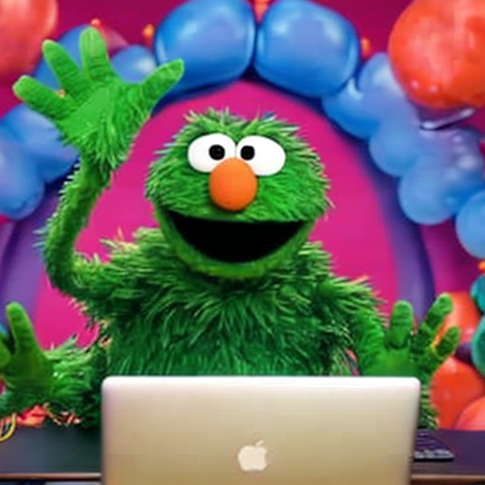
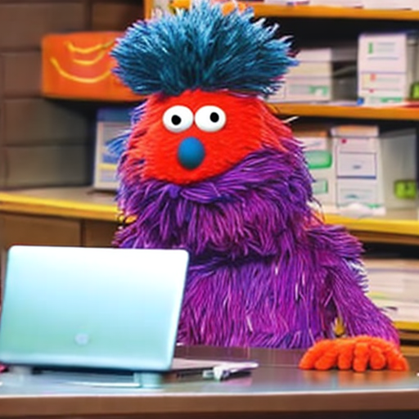
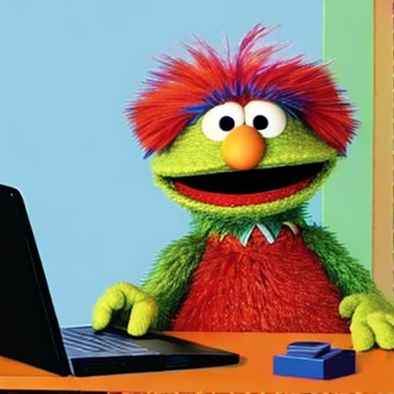
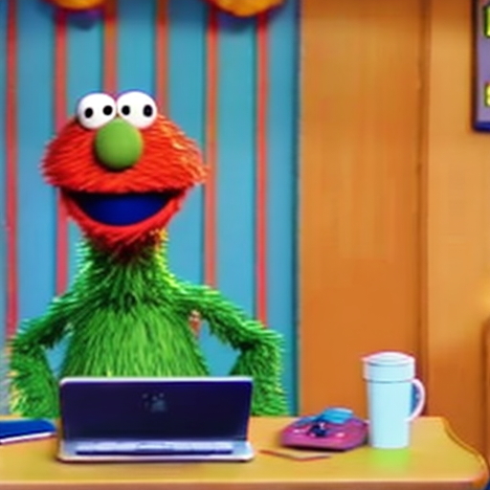
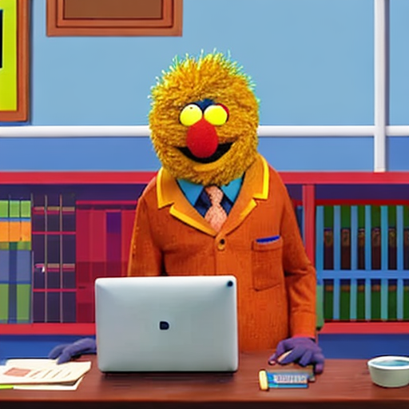
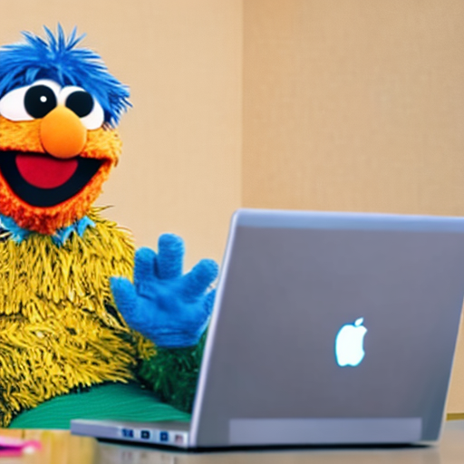
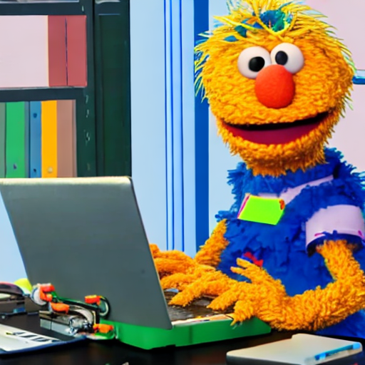
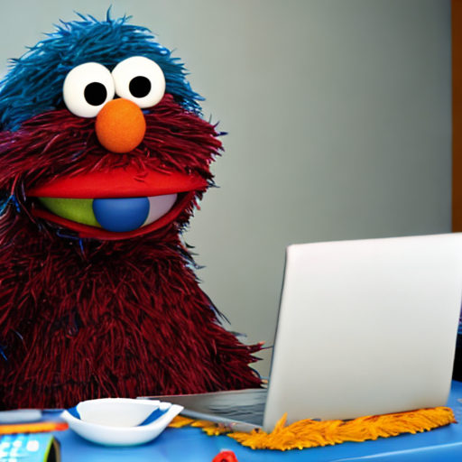
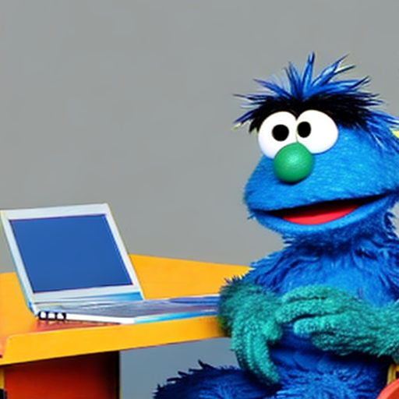

Slide 15
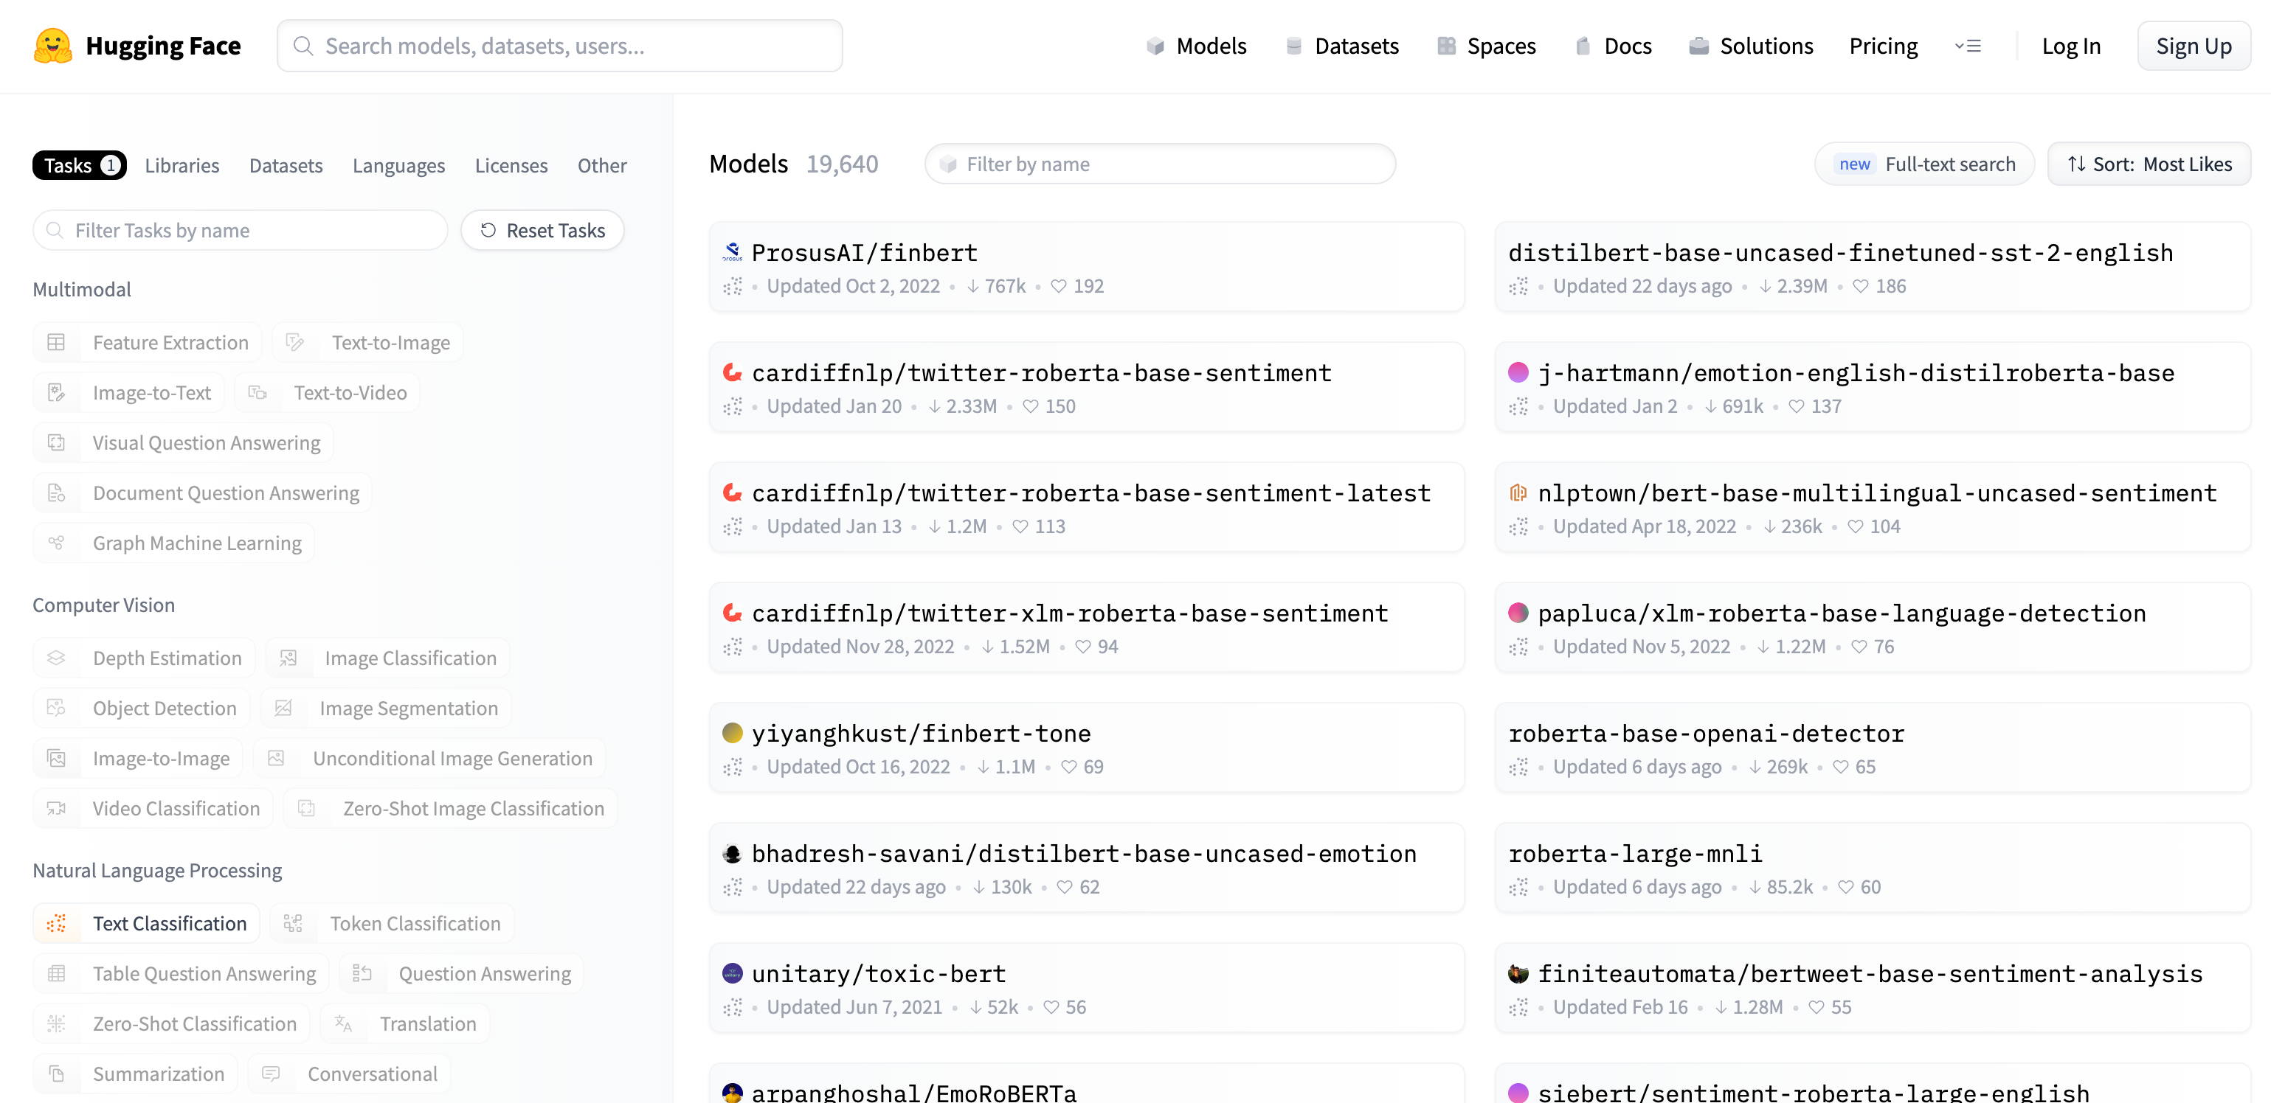

https://huggingface.co/models

Slide 16
Fine tuning BERT
For Sentiment Classification
Images generated by stable-diffusion.
Prompts:
Ernie from sesame street is a DJ with headphones on one ear
Bert from sesame street dressed as a synthesizer

Slide 17
Why are you here?
Me?
Image generated by stable-diffusion.
Prompt: Sesame street character sitting at a desk

Slide 18
Tune in to Part 2:
Open Source NLP models on Hugging Face
An NLP model’s vocabulary, embeddings and Tokenizers
I want to specialize in NLP!
Additional Resources:
NLP Basecamp and Bert Collection by Chris Mccormick
Illustrated BERT by Jay Alammar
Sequence Models Course by Andrew Ng
Image generated by stable-diffusion.
Prompt: A polyglot esame street character sitting at a desk

Slide 19
I’m a product manager and sentiment analysis is on our roadmap for Q3.
Tune in to Part 2 and 3:
- Leveraging open-source datasets and models for fast MVP hypothesis testing
Additional Resources:
[ Sentiment Analysis Case studies ]
Image generated by stable-diffusion.
Prompt: A sesame street character who is a product manager sitting at a desk

Slide 20
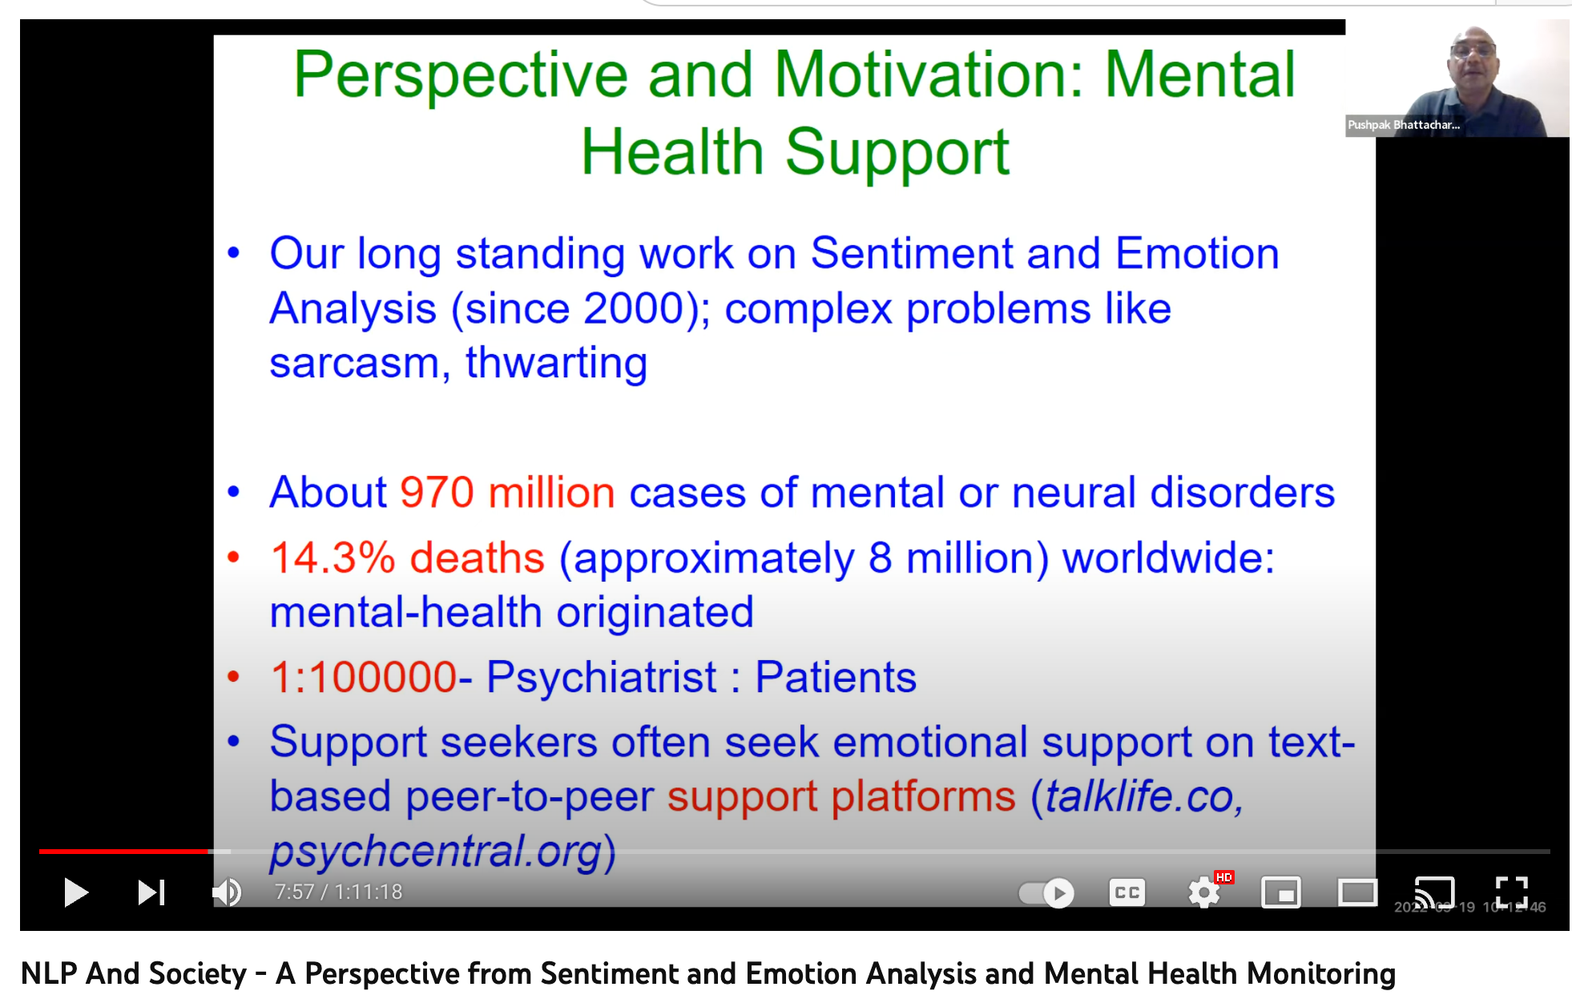
I want to apply what I learn today to improve society
Image generated by stable-diffusion.
Prompt: A super hero sesame street character sitting at a desk

Slide 21
I’m a software engineer who was laid off and I want to learn fine-tuning for vision and generative models too.
Tune in to Parts 3 and 4:
Reusing our code to train on a new data set for a new objective
The SOTA Landscape
Additional Resources:
Hugging Face youtube series and documentation
MLOps.community
Image generated by stable-diffusion.
Prompt: A sesame street character who is a software engineer sitting at a desk

Slide 22
Ultimately, we all follow tutorials hoping to transfer what we learn to use-cases we care about

Slide 23
Ultimately, we all follow tutorials hoping to transfer what we learn to use-cases we care about
Transfer Learning
Image generated by stable-diffusion.
Prompt: sesame street character amazed by understanding a new concept

Slide 24
Transfer Learning
From Wikipedia
Transfer learning (TL) is a research problem in machine learning (ML) that focuses on applying knowledge gained while solving one task to a related task.^{[1]} For example, knowledge gained while learning to recognize cars could be applied when trying to recognize trucks. This topic is related to the psychological literature on transfer of learning, although practical ties between the two fields are limited. Reusing/transferring information from previously learned tasks to new tasks has the potential to significantly improve learning efficiency.^{[2]}

Slide 25
Transfer Learning (Machines)
Transfer of Learning (Humans)
From Wikipedia
Transfer learning (TL) is a research problem in machine learning (ML) that focuses on applying knowledge gained while solving one task to a related task.^{[1]} For example, knowledge gained while learning to recognize cars could be applied when trying to recognize trucks. This topic is related to the psychological literature on transfer of learning, although practical ties between the two fields are limited. Reusing/transferring information from previously learned tasks to new tasks has the potential to significantly improve learning efficiency.^{[2]}
From Wikipedia
Transfer of learning occurs when people apply information, strategies, and skills they have learned to a new situation or context. Transfer is not a discrete activity, but is rather an integral part of the learning process. Researchers attempt to identify when and how transfer occurs and to offer strategies to improve transfer.
=

Slide 26
Transfer Learning (Machines)
Transfer of Learning (Humans)
BERT:
Base knowledge:
A statistical understanding of natural language
Learned from:
”Dummy tasks”: Masked Language Modeling (MLM) & Next Sentence Prediction (NSP)
Today’s Fine-tuning Objective:
Learn how to classify the sentiment of piece of text
You:
Base knowledge:
An intuitive and rule-based understanding of language
Learned from:
”Dummy tasks”: Watching Sesame Street, reading Nancy Drew, grammar classes
Today’s Fine-tuning Objective:
Learn how to fine-tune a model for a custom task
=

Slide 28
https://huggingface.co/models

Slide 29
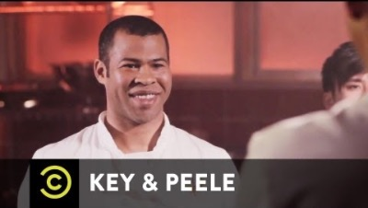
Interpreting Sentiment

Slide 30
I want to apply what I learn today to improve society
https://www.youtube.com/watch?v=d-deCau9ud4
Prompt: A super hero sesame street character sitting at a desk

Slide 31
14.3% of deaths worldwide are attributable to mental disorders^{[1]}
One in 100 deaths is by suicide ^{[2]}
https://pubmed.ncbi.nlm.nih.gov/25671328/
https://www.who.int/news/item/17-06-2021-one-in-100-deaths-is-by-suicide
https://www.ijcai.org/proceedings/2022/0704.pdf
Prompt: A super hero sesame street character sitting at a desk

